Slide 1


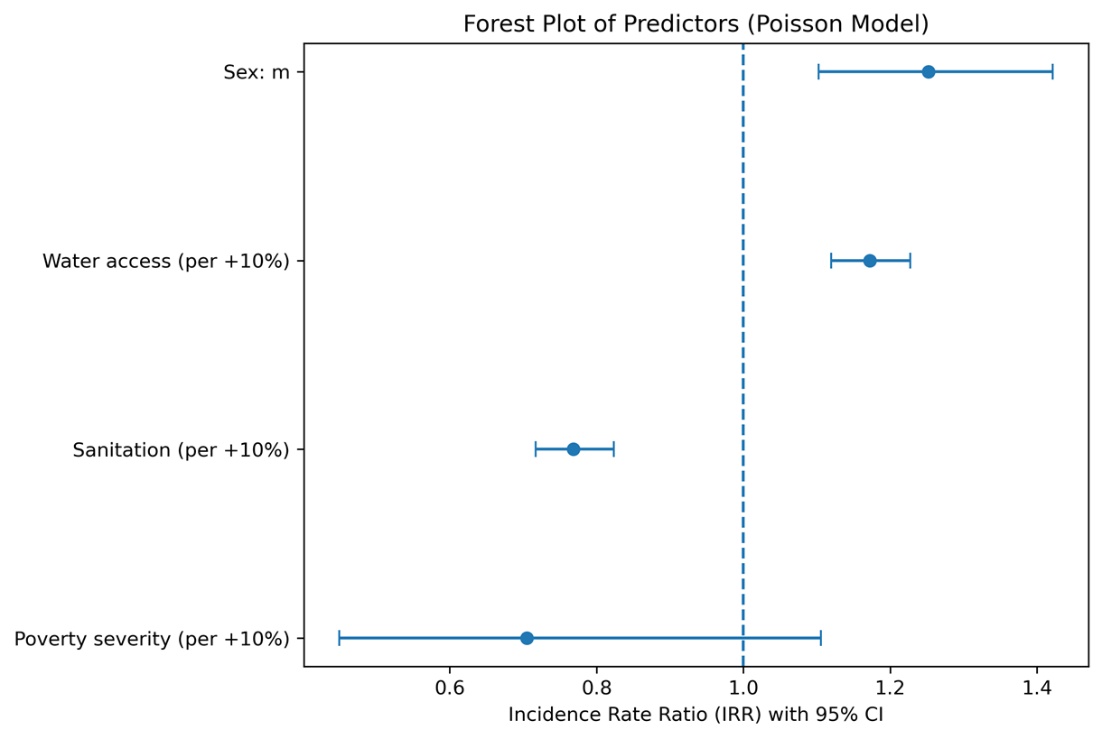
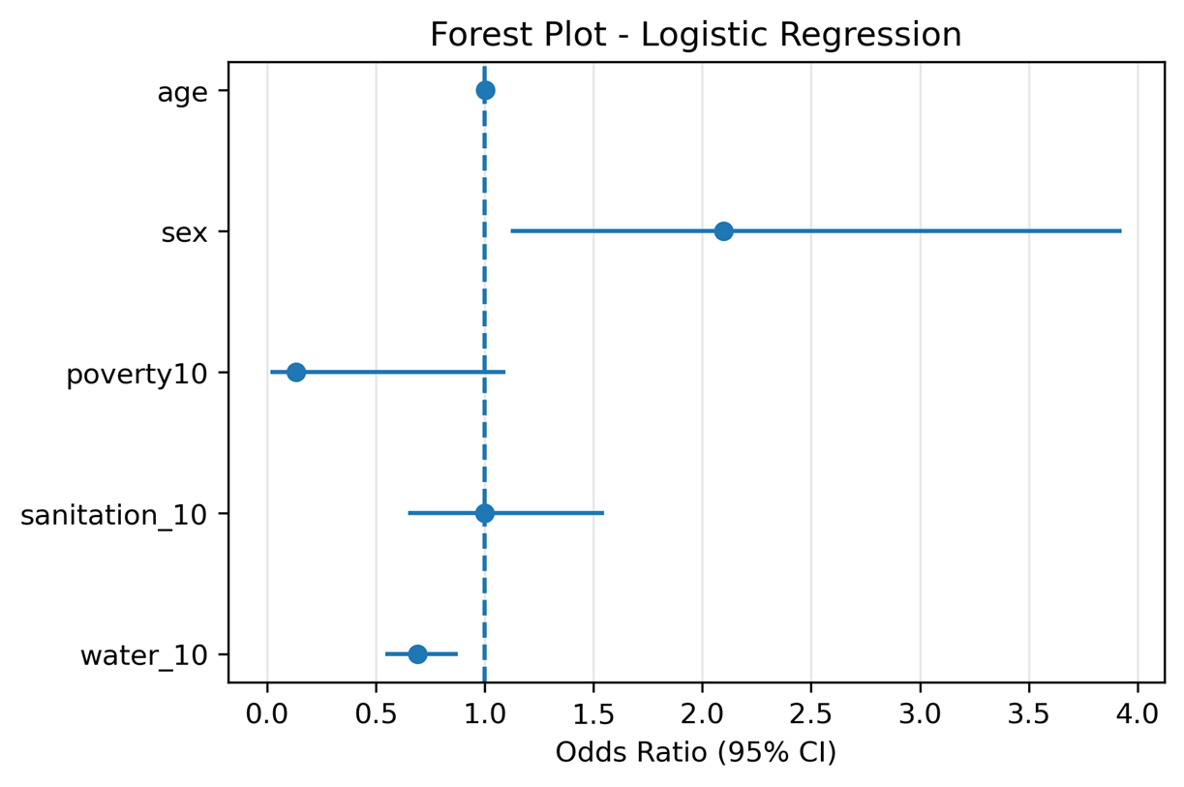
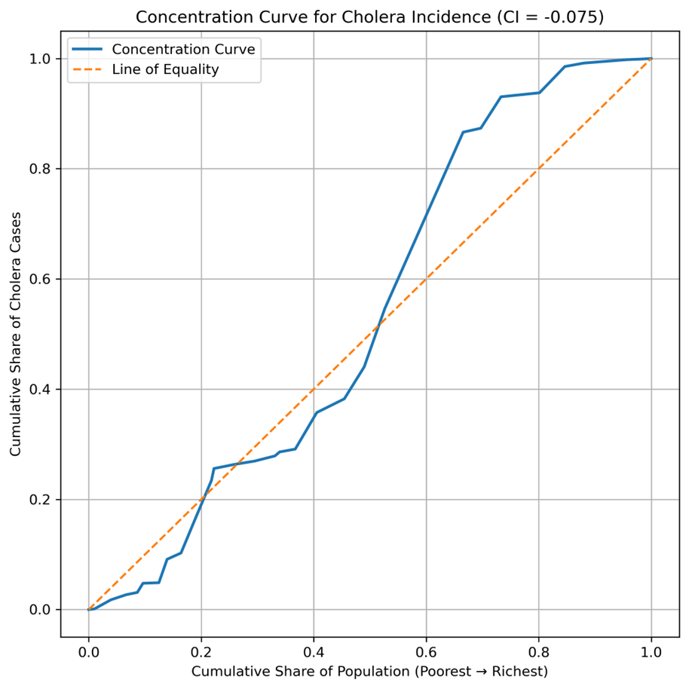
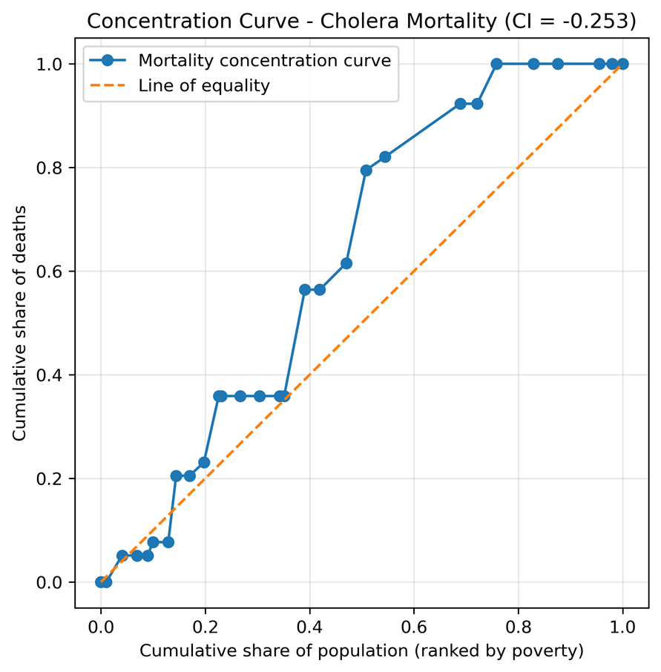
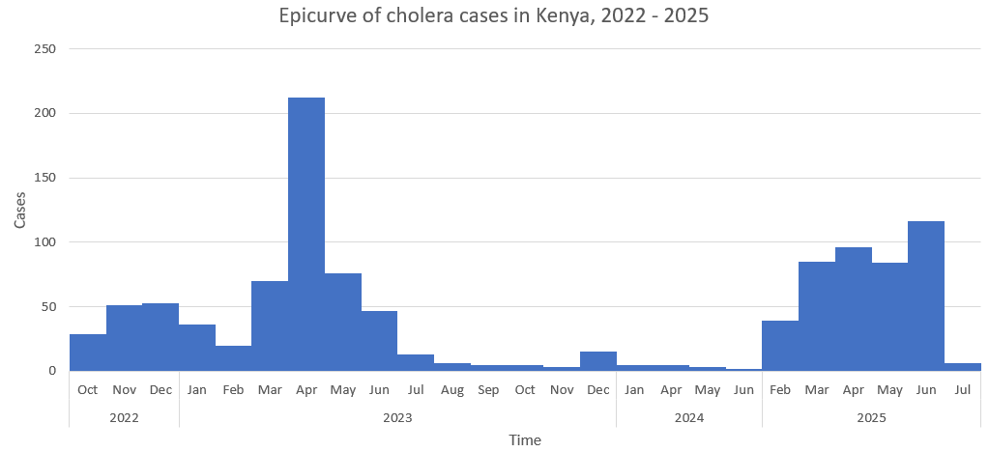
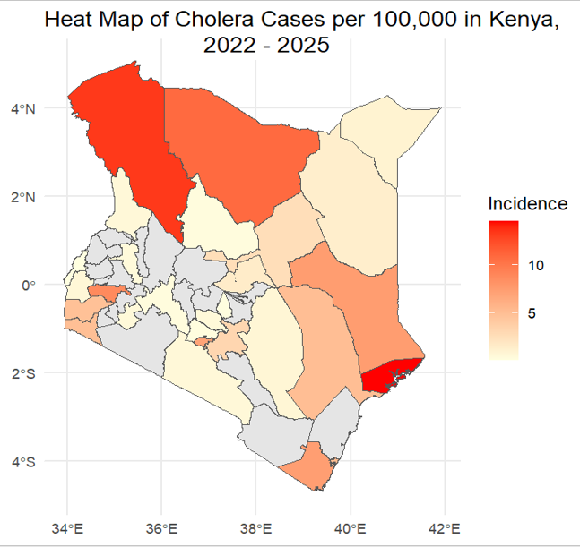
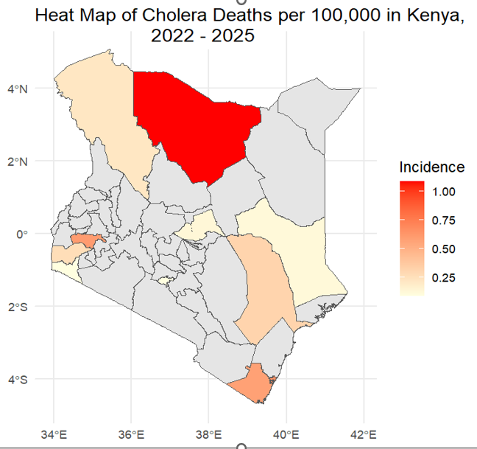



Statistical Modelling of Cholera Incidence in Kenya: A Risk Factor Approach for Equitable Public Health Response
Gerald G. Githinji¹, Sahar Trabelsi^{2,3}
1: Kenya National Public Health Institute (KNPHI) 2:Center for Epidemiological Modelling and Analysis (CEMA/UON) 3: Institut Pasteur de Tunis
BACKGROUND
Cholera is a severe diarrheal disease caused by contaminated water or food, leading to rapid dehydration and potentially death if untreated. In Kenya, cholera outbreaks have become recurrent, particularly in the last few years, threatening public health and straining healthcare resources. Understanding the social vulnerabilities that contribute to these outbreaks is essential for developing effective public health responses and ensuring equitable access to care.
RESULTS
OBJECTIVE: To develop and apply statistical models to identify and quantify social vulnerabilities predictors associated with cholera incidence in Kenya for equitable public health response
METHODOLOGY: A retrospective analysis of cholera surveillance data from 2022–2025 obtained from the Ministry of Health, Kenya. Social predictors were obtained from: Kenya Demographic and Health Survey (KDHS) and Kenya Continuous Household Survey (KCHS) - Kenya National Bureau of Statistics (KNBS).
STATISTICAL ANALYSIS: Descriptive Analysis used to get summary statistics of cholera cases and deaths. Statistical modelling was done using Poisson regression model (cases) and logistic regression model (deaths). Equity assessment was done using the concentration curves and the concentration index (CI) to measure the socio-economic inequality in cholera incidence and mortality. Microsoft Excel and R software used for analysis
DISCUSSION
Better sanitation is associated with a reduction in cholera incidence
Sex is a Risk Factor: Sex (male) is associated with an increased risk. Males also have a higher odds of cholera death compared to females
Areas with reported water access still experienced cases, suggesting water contamination rather than lack of water.
An increase in access to water is associated with a decrease in the odds of cholera death
Equity assessment of cholera incidence had a mild socioeconomic inequality in cholera incidence
Equity assessment of cholera deaths showed the concentration curve lies above the line of equality, indicating that cholera deaths are disproportionately concentrated in poorer counties
RESULTS
CONCLUSIONS
Cholera in Kenya is preventable, but only if responses are guided by evidence and equity. This study shows that social vulnerabilities such as access to safe drinking water, improved sanitation, gender equality and decreasing poverty could reduce cholera incidences and odds of death from cholera. Socioeconomic inequalities also affect the chances of surviving after infection, likely due to differences in access to care and living conditions. County-specific strategies can significantly reduce these cholera incidences and mortality.
We acknowledge the AMAX Project for its support and contribution to this work
Contact: gggikonyo@gmail.com , sahar.trabelsi@cema.africa

